Slide 1
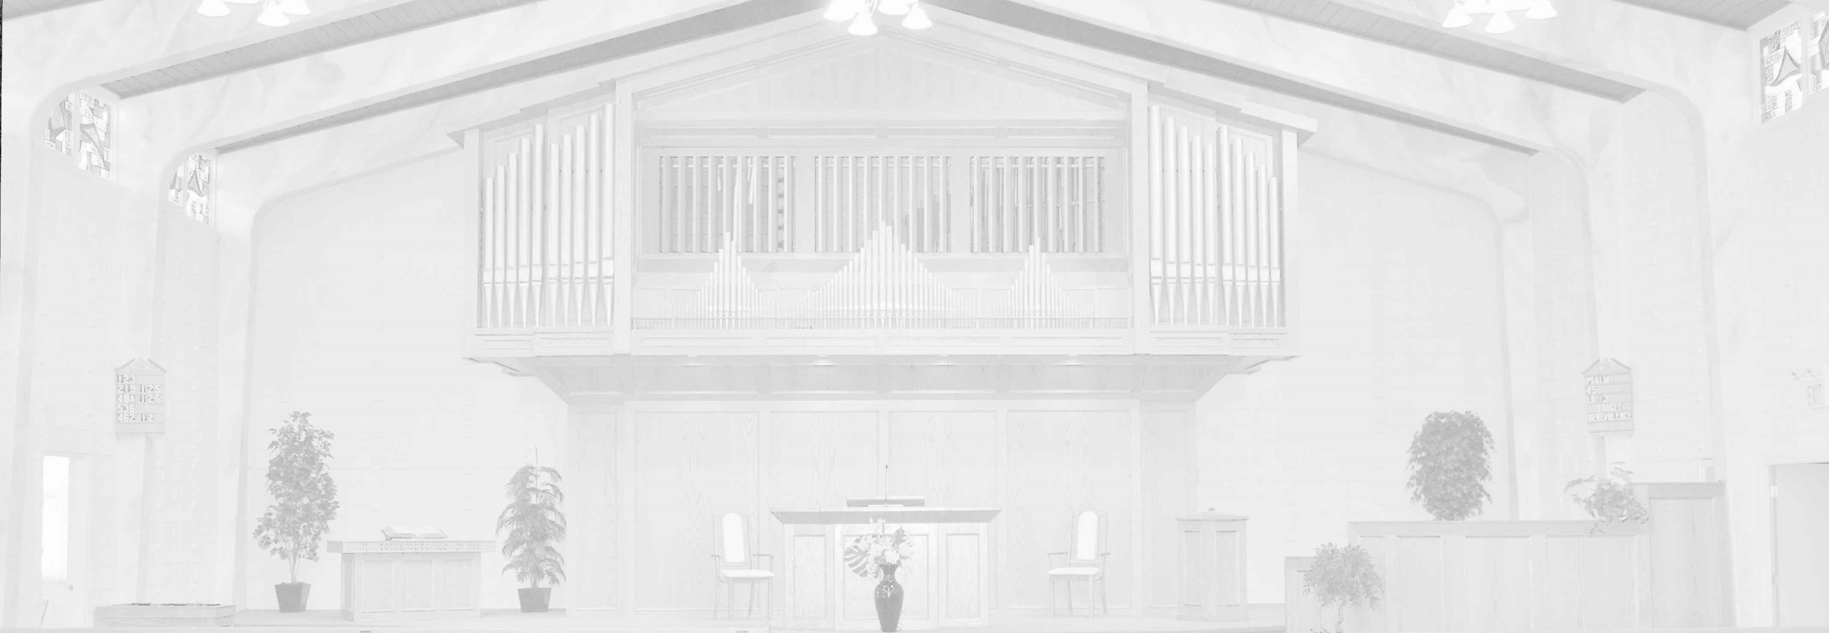
Cornerstone United Reformed Church of Edmonton
2026-03-05, Evening Service
Scripture as summarized in Lord’s Day 24
“The Gracious Gift of Good Works”
Pastor Vander Lei

Slide 2
#148B Hallelujah, Praise Jehovah
2. Let them praises give Jehovah, they were made at his command; them forever he established, his decree shall ever stand. From the earth O praise Jehovah, all you seas, you monsters all, fire and hail and snow and vapors, stormy winds that hear his call. Let them praises give Jehovah, for his name alone is high, and his glory is exalted, and his glory is exalted, and his glory is exalted far above the earth and sky.
Copyright Trinity Psalter Hymnal, 2018, used by permission

Slide 3
3. All you fruitful trees and cedars, all you hills and mountains high, creeping things and beasts and cattle, birds that in the heaven fly, kings of earth and all you people, princes great, earth’s judges all, praise his name, young men and maidens, aged men and children small. Let them praises give Jehovah, for his name alone is high, and his glory is exalted, and his glory is exalted, and his glory is exalted far above the earth and sky.

Slide 4
#172 Speak, O Lord
1. Speak, O Lord, as we come to you To receive the food of your Holy Word. Take your truth, plant it deep in us; Shape and fashion us in your likeness, That the light of Christ might be seen today In our acts of love and our deeds of faith, Speak, O Lord, and fulfill in us All your purposes for your glory.
Copyright 2006 Thankyou Music (PRS)

Slide 5
2. Teach us, Lord, full obedience Holy reverence, true humility Test our thoughts and our attitudes In the radiance of your purity. Cause our faith to rise, cause our eyes to see Your majestic love and authority. Words of pow’r that can never fail, Let their truth prevail over unbelief.

Slide 6
3. Speak, O Lord, and renew our minds; Help us grasp the heights of your plans for us; Truths unchanged from the dawn of time, That will echo down thro’ eternity. And by grace we’ll stand on your promises; And by faith we’ll walk as you walk with us. Speak, O Lord, ‘til your church is built, And the earth is filled with your glory.

Slide 7
#455 I Need Thee, Precious Jesus
1. I need thee, precious Jesus, for I am full of sin; my soul is dark and guilty, my heart is dead within. I need the cleansing fountain where I can always flee, the blood of Christ most precious, the sinner’s perfect plea.
Copyright Trinity Psalter Hymnal, 2018, used by permission

Slide 8
2. I need thee, precious Jesus, for I am very poor; a stranger and a pilgrim, I have no earthly store. I need the love of Jesus to cheer me on my way, to guide my doubting footsteps, to be my strength and stay.

Slide 9
3. I need thee, precious Jesus, and hope to see thee soon, encircled with the rainbow and seated on thy throne. There, with thy blood-bought children, my joy shall ever be, to sing my Jesus’ praises, to gaze, O Lord, on thee.

Slide 10
#119C Do Good to Me and I Will Live
2. A pilgrim on the earth am I; hide not your good commands from me. Consumed with longing is my soul, because your laws I yearn to see.

Slide 11
3. The proud and cursed ones you rebuke, who from your precepts go astray. Remove contempt and scorn from me, for all your statutes I obey.

Slide 12
4. Though rulers sit and plot my harm, I meditate on your decree. Your statutes bring me great delight, for they are advisors unto me.

Slide 13
Offerings
Budget
Reformed Missions—Costa Rica
Giving details have been provided to members. Others who may wish to give may contact the church for additional details.

Slide 14
Apostles Creed
I believe in God the Father Almighty,
Maker of heaven and earth.
I believe in Jesus Christ, his only begotten Son, our Lord;
who was conceived by the Holy Spirit, born of the virgin Mary;
suffered under Pontius Pilate;
was crucified dead and buried;
he descended into hell;
the third day he arose again from the dead;
he ascended into heaven,
and sits at the right hand of God the Father Almighty;
from there he shall come to judge the living and the dead.
I believe in the Holy Spirit;
the holy catholic church;
the communion of saints;
the forgiveness of sins;
the resurrection of the body;
and the life everlasting. Amen.

Slide 15
#999 A song
1. aljdf al;kjdf ;lakjdfj ureionbn a;nbpoe na;lkd pna nb

Slide 16
2. alkdjf alkdj lkajlkd an falkj nadf

Slide 17
3. lakjdl f al;kjd ajdl;k alk lanlk djf alkn djal;k flan ;ldkna fn

